Slide 1
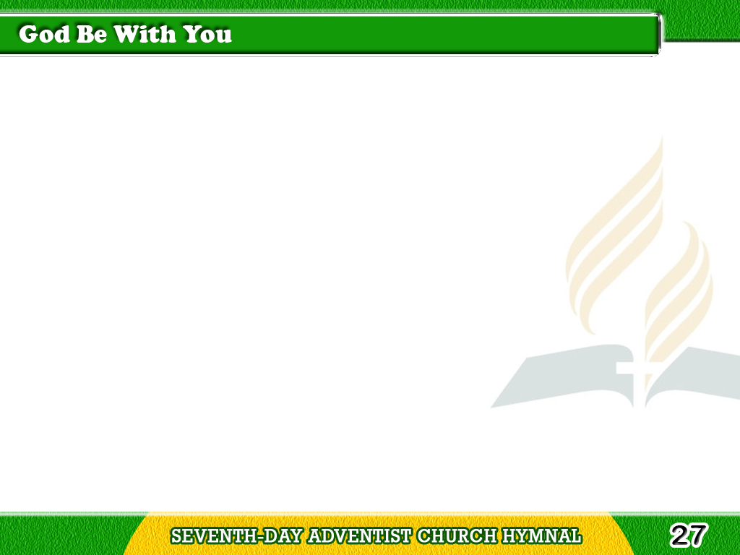
1/4
God be with you
till we meet again;
By His counsels guide,
uphold you,
Tagalog
Version

Slide 2
1/4
With His sheep
securely fold you;
God be with you
till we meet again.
Tagalog
Version

Slide 3
1/4
Chorus
Till we meet, till we meet,
Till we meet at Jesus’ feet,
Till we meet, till we meet,
God be with you
till we meet again.
Tagalog
Version

Slide 4
2/4
God be with you till
we meet again;
‘Neath His wings
protecting hide you,
Tagalog
Version

Slide 5
2/4
Daily manna still
provide you;
God be with you
till we meet again.
Tagalog
Version

Slide 6
2/4
Chorus
Till we meet, till we meet,
Till we meet at Jesus’ feet,
Till we meet, till we meet,
God be with you
till we meet again.
Tagalog
Version

Slide 7
3/4
God be with you
till we meet again;
When life’s perils
thick confound you,
Tagalog
Version

Slide 8
3/4
Put His arms unfailing
round you;
God be with you
till we meet again.
Tagalog
Version

Slide 9
3/4
Chorus
Till we meet, till we meet,
Till we meet at Jesus’ feet,
Till we meet, till we meet,
God be with you
till we meet again.
Tagalog
Version

Slide 10
4/4
God be with you
till we meet again;
Keep love’s banner
floating o’er you,
Tagalog
Version

Slide 11
4/4
Smite death’s threatening
wave before you;
God be with you
till we meet again.
Tagalog
Version

Slide 12
4/4
Chorus
Till we meet, till we meet,
Till we meet at Jesus’ feet,
Till we meet, till we meet,
God be with you
till we meet again.
Tagalog
Version

